Slide 1
Value-Based Procurement
in Healthcare
Arted Health Economics Working Group
September 2021

Slide 2
“There are more important criteria than the cost...”

Slide 3
In Germany, reoperation rates following hip
replacement surgery are 18 times higher in underperforming
hospitals compared to high-performing hospitals
Source: https://www.bcg.com/publications/2020/procurement-unlocks-value-based-health-care

Slide 4
Across the EU, health expenses
are growing faster than GDP growth.
According to Eurostat, health care service expenses, in particular, are increasing disproportionately.
These costs constitute
approximately 70%
of the total health expenses.
Source: https://www.bcg.com/publications/2020/procurement-unlocks-value-based-health-care

Slide 5
According to the 2017 OECD report,
10% to 34%
of health expenses is wasted due to inadequate care.
Source: https://www.bcg.com/publications/2020/procurement-unlocks-value-based-health-care

Slide 6
Benefit for the Patient
Value in Health Care
Total Cost
Value refers to the most probable health gain patients can achieve, relative to the total cost of treatment.
Other key elements that make up the value are product suitability and treatment suitability. Undertreatment, overtreatment, or treatment in unsuitable conditions may undermine the value.
Source: What is Value in Health Care? Michael Porter, New England Journal of Medicine, 23 December 2010.

Slide 7
A Holistic Health Ecosystem Where Innovation and Sustainability Is Possible with Value-Based Procurement
HEALTHCARE
PROFESSIONALS
Value-based healthcare would create a holistic health ecosystem that would allow for long-term financial sustainability and wider use of technology innovations, cover patients, service providers, suppliers, and decision makers and benefit the society.
PATIENTS
RESULTS
INNOVATION
SOCIOECONOMIC IMPACT
COSTS
SUPPLIERS
HEALTHCARE SYSTEM
SUSTAINABILITY

Slide 8
Value-Based Procurement in Healthcare
THE PATIENT
SERVICE
PROVIDER
THE PAYER
THE SUPPLIER
SOCIETY
Clinical
Outcome
Improvement
High Patient
Satisfaction
Patient
Care
Efficiency
Cost
Control
Financial
Risk
Decrement
Health
Expense
Decrement
Societal
Health
Improvement
Price and Quality
Compliance
Value-based procurement, as part of a value-based healthcare, aims to evaluate the economically most advantageous bid in proportion to the best price-quality ratio, thereby reducing the long-term costs.
Value-based procurement focuses not only on the price of a product or service but also the total value it can generate.
The Boston Consulting Group research company and MedTech Europe have developed a new value-based procurement framework in line with EU regulations. The competitive environment resulting in connection with unsustainable low prices would be challenging for both local companies and international prices, and focusing on low prices would reduce innovation and discourage the adoption of new technologies as well.

Slide 9
The new mindset:
Rational purchasing with evidence-based and comprehensive assessment
“Price Only”
Currently the most used criterion (!)
“Non-Price Factors”
Consideration of additional costs to suppliers
“Result-orientedness”
“Values” that the product brings to stakeholders
Overall cost reduction opportunities and the most economical outcomes for all stakeholders...
Focusing on values and outcomes that matter to patients, the system and society...
Optimization, professionalization, harmonization in purchasing methodologies, standardization, flexibility at the local level, comparison, cooperation
Widespread use of good practices
Key benefits expected at the national level in public procurement
Source: MedTech Europe, BCG

Slide 10
Value-based purchases/procurements based on timely
and accurate need evaluation provide the following advantages:
Improved patient outcomes,
Lower total-costs thanks to the reduced complications and inefficiencies,
More benefits for healthcare professionals as well as other stakeholders such as purchasers and suppliers.
Source: Implementing value-based pricing for pharmaceuticals in the UK - www.2020health.org
https://www.bcg.com/publications/2020/procurement-unlocks-value-based-health-care

Slide 11
Examples of System Application: Wales
NHS Wales (Wales National Health Service) is the first healthcare system to systematically apply value-based procurement to large central tenders in order to integrate and improve care in areas such as blood thinning and wound management.
If you buy cheap, you buy twice. Lowest-price procurement leads to short-term consideration of the product in isolation from its use. Instead, we need suppliers to become more broadly involved in fixing our most urgent care pathway pain points, looking at efficacy, efficiency, and impact on patient outcomes.
Head of Sourcing at NHS Wales
Andy SMALLWOOD
Source: https://www.bcg.com/publications/2020/procurement-unlocks-value-based-health-care

Slide 12
Need for
Value-Based Procurement in Healthcare in Turkey

Slide 13
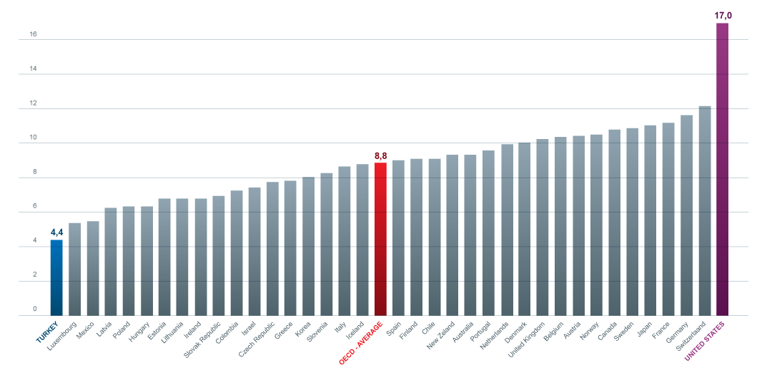
As Expenses Increase, the Share Allocated to Health Decreases
Ratio of Health Expenses to 2019 GDP - OECD Countries
As the negative impact of demographic indicators (e.g. population, aging) and data (e.g. epidemiology, increasing disease burdens) on the health economy gradually increases, the share of health in GDP decreases.
The share allocated to health in Turkey is the lowest share allocated to health among OECD countries.
Source: OECD Data

Slide 14
Share of Public Health Expenses in GDP
Decreases in Turkey While Increasing in Other Countries.
(%) Share of Recurring Public Health Expenses in GDP
USA
OECD
TURKEY
USA
OECD
Turkey
Source: Health Statistics Yearbook 2018, OECD Health Data 2020
Note: Calculations are based on the recurring healthcare expenditure.
The TurkStat 2019 data will be announced on November 19.

Slide 15
Per Capita Total Healthcare
Expenditure in Foreign Currency Decreases
Per Capita Total Healthcare Expenditure
TRY Nominal
US$
PPP* US$
Source: Health Statistics Yearbook 2018 Turkstat 2019 data will be announced on November 19, 2020.
*PPP: Purchasing Power Parity

Slide 16
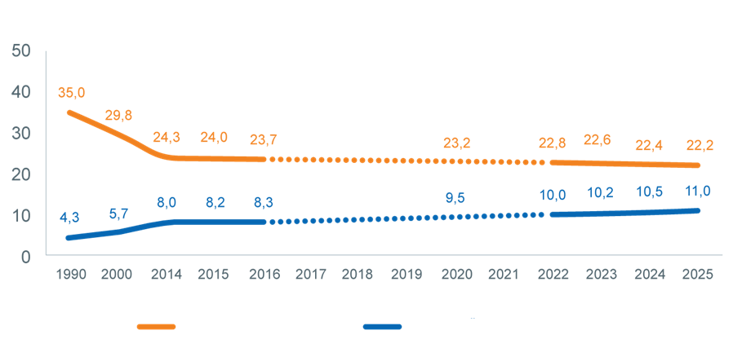
Young Population Declines, Elderly Population Grows
(%) Share of Populations
(%) Share of Population Aged 0-14
(%) Share of Population Aged 65 and Over
Source: Turkish General Censuses of 1990-2000, Turkstat Population Projections for 2020-2025 and Turkstat Address-Based Population Registration System (ADNKS) data for 2014-2019

Slide 17
We are a solution partner in value-based healthcare in Turkey
6000: Nearly 6000 healthcare workers (doctors, nurses, lab technicians etc.) have been reached out with medical trainings provided by all of our members in the last year.
14 : In addition to Sales & Marketing teams, 14 of our members also have Medical support teams trained in medicine/pharmaceutics/nursing.
15: 15 of our members have a Healthcare Professional Training Center.

Slide 18
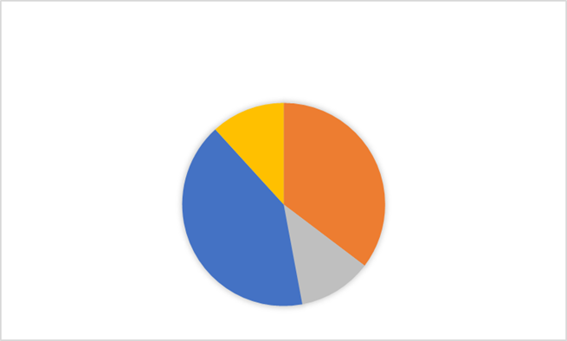
We are a solution partner in value-based healthcare in Turkey
NUMBER OF PHYSICIAN ASSOCIATIONS IN COLLABORATION WITH OUR MEMBERS
> 20
12%
10-20
32%
41%
12%
1-5
5-10
All our members support medical conferences all the year round, and
the total number of collaborations / supports is more than 150 annually.

Slide 19
The global budget allocated to R&D by our members
contributing to value-based healthcare
26%
7%
60%
7%
250-500
million USD
500-900
million USD
1-5
billion USD
5-10
billion USD

Slide 20
Case Studies from Turkey
Cost-Effectiveness & Cost of Illness

Slide 21
Study on Choosing the Correct Peripheral Catheter
Results Dependent on Catheter Characteristics
Catheter A
70% initial intervention success
20.9% rate of catheter removal due to complication
54% need for extra catheter use
3.6% rate of catheters showing a defect upon unpacking
$2,000 cost in 1000 catheter days
51%
$345
Cost-Effectiveness
per
1000 catheters!
40%
44%
52%
Catheter B
84% initial intervention success
9.7% rate of catheter removal due to complication
26% need for extra catheter use
0% rate of catheters showing a defect upon unpacking
$1,655 cost in 1000 catheter days
100%
Total Number of Complications
Catheter Replacement Due to Complication
Packaging/Product Defect
Need for Extra Catheter
Initial Intervention Failure
Catheter A
Catheter B
Source: Dizbay, M., Ozger, H. S., Bilgetekin, I., Basyurt, R., Yurtal, O., Simsek, H., & Aksakal, N. B. (2019). Cost-effectiveness analysis of low-cost, domestic short peripheral catheters versus higher-priced, imported short peripheral catheters. Journal of Infusion Nursing, 42(4), 209-214.

Slide 22
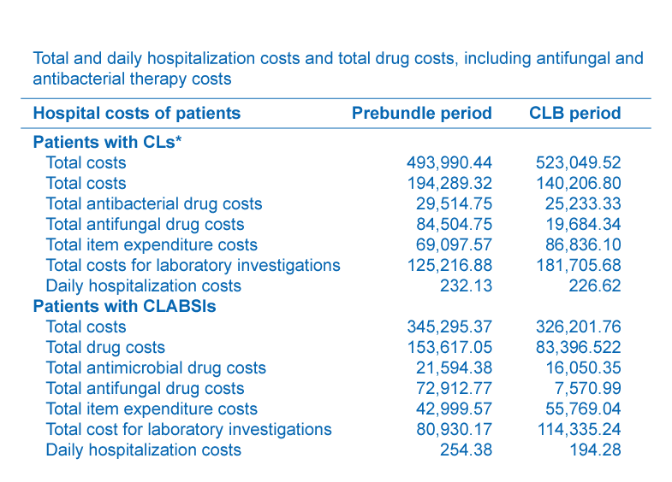
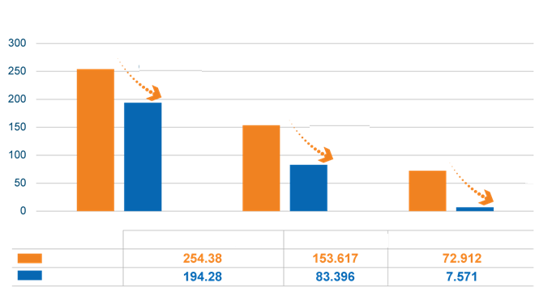
Bundle Studies
Cost-Effectiveness (USD)
24%
46%
89%
Daily Hospitalization Cost
Total Drug Cost
Total Antifungal Drug Cost
Before Bundle
After Bundle
According to the study;
$60 cost-effectiveness was provided for each patient, each day.
Source: Devrim, İ., Yaşar, N., İşgüder, R., Ceylan, G., Bayram, N., Özdamar, N., ... & Ağın, H. (2016). Clinical impact and cost-effectiveness of a central line bundle including split-septum and single-use prefilled flushing devices on central line-associated bloodstream infection rates in a pediatric intensive care unit. American journal of infection control, 44(8), e125-e128.

Slide 23
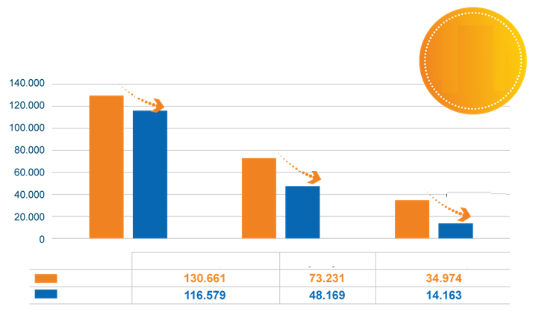
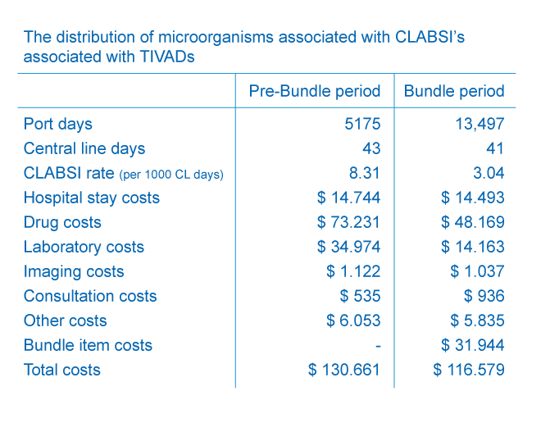
Bundle Studies
$124 cost-effectiveness for every $1 spent!
Cost-Effectiveness (USD)
11%
34%
60%
Total Cost
Drug Cost
Laboratory Costs
Before Bundle
After Bundle
According to the study;
In addition to the cost-effectiveness in total cost; the development of 71 Catheter-Related Bloodstream Infections was prevented, providing an additional $208,977 cost-effectiveness.
Thus, $223,059 cost-effectiveness in total was achieved.
Source: Devrim, İ., Yaşar, N., İşgüder, R., Ceylan, G., Bayram, N., Özdamar, N., ... & Ağın, H. (2016). Clinical impact and cost-effectiveness of a central line bundle including split-septum and single-use prefilled flushing devices on central line-associated bloodstream infection rates in a pediatric intensive care unit. American journal of infection control, 44(8), e125-e128.

Slide 24
Safe Infusion Practices
Every year 44,000 - 99,000 people die due to medical errors.
In the light of data obtained from the Turkish Ministry of Health’s National Safety Reporting System between March 2016 and December 2017; the rate of incorrect drug preparation is 6.89%, and the rate of incorrect drug administration is 2.6%.
For pediatric intensive care, these rates are 14%. Preventable drug error is 38%, and treatment initiation with the wrong infusion rate is 43%.
Clinical Treatment
Extended Hospitalization Period
Additional Cost
Hemorrhage Hypotension Cardiac Arrest
Full ICU treatment
(monitoring, nutrition, ventilation etc.)
4-30 days ICU + 4-30 days inpatient floor
€7,566 to €56,670
Incorrect antibiotic treatment AMR Incorrect drug rate
1-7 days ICU + 1-7 days inpatient floor
€1,136 to €7,952
Intermediate ICU support
Vascular damage (infiltration, extravasation etc.)
0 days ICU + 0-3 days inpatient floor
€0 to €400
Regional therapy
Source: 1. Keohane CA, Hayes J, Saniuk C, Rothschild JM, Bates DW. Intravenous medication safety and smart infusion systems: lessons learned and future opportunities. J Infus Nurs. 2005;28(5):321-328. doi: 10.1097 / 00129804 - 200509000-00005 2. Çakmak C et al. The Evaluation of Medical Errors Through Turkey National Safety Reporting System (SRS). Hacettepe Journal of Health Administration, 2018; 21(3): 423-448 3. Narula, Priya et al.The frequency and importance of reported errors related to parenteral nutrition in a regional paediatric centre. European e-Journal of Clinical Nutrition and Metabolism, Volume 6, Issue 3, e131 - e134 4. Maddox RR et al. Intravenous Infusion Safety Initiative: Collaboration, Evidence-Based Best Practices, and “Smart” Technology Help Avert High-Risk Adverse Drug Events and Improve Patient Outcomes. Advances in Patient Safety: New Directions and Alternative Approaches (Vol. 4: Technology and Medication Safety). Rockville (MD): Agency for Healthcare Research and Quality (US); 2008 Aug. 5. Phillips J et al. Retrospective analysis of mortalities associated with medication errors. Am J Health Syst Pharm. 2001 Oct 1;58(19):1835-41.

Slide 25
Economic Importance of Obesity Cost
and Bariatric Surgery for Turkey
It is aimed to determine the disease burden of obesity and to identify the economic value of bariatric surgery.
The cost of having an operation and not having an operation for an obese patient with a BMI ≥ 40 kg/m2 (in terms of bundle pricing of operations) (US$)
 |  | Postoperative Cost
Type of Cost for Obese Patient | Amount for Obese Patient Type | Year 1 | Year 2 | Year 3 | Year 4 | Year 5
Cost of Ischemic Heart Disease (A) | 917 | 687.88 | 687.88 | 687.88 | 687.88 | 687.88
Cost of Hypertensive Heart Disease (B) | 164 | 81.83 | 40.92 | 20.46 | 20.46 | 20.46
Cost of Diabetes Mellitus (C) | 403 | 134.40 | 100.80 | 100.80 | 100.80 | 100.80
Cost of Osteoarthritis (D) | 162 | 138.56 | 115.47 | 115.47 | 115.47 | 115.47
Cost of Ischemic Heart Disease (E) | 389 | 194.57 | 194.57 | 194.57 | 194.57 | 194.57
Price of Operation (F) | 1,716.76 | 570.44 | 461.80 | 393.79 | 39.44 | 39.44
Total Cost with Operation (A+B+C+D+E+F) | 3,752 | 1,808 | 1,808 | 1,513 | 1,159 | 1,159
Total Cost without Operation (A*B*C*D*E) | 2 035 | 2035 | 2 035 | 2035 | 2 035 | 2 035
According to the study;
In the current reimbursement conditions, the economic burden of surgery is ruled out after the fourth year. For obese patients with a BMI = 35-40 kg/m2, this happens after the third year. Furthermore, in many articles (found by reviewing the literature), it is stated that this technology lowers the cost of obesity in the years following the operation.
It is also stated that, if the BMI is ≥ 35 kg/m2 and a comorbid disease exists, bariatric surgery will provide both clinical and economic effectiveness.
Keeping obese patients with a BMI = 35-40 kg/m2 within the scope of reimbursement will increase the number of patients, but in general, this will have a positive impact on health expenses thanks to the cost reduction and complication management provided by the operation.

Slide 26
Case Studies
from Various Countries
Studies that can be Applied in Turkey

Slide 27
Cost Comparison and Budgetary Impact Model for Radical Prostatectomy in the United Kingdom¹
Purpose | To assess the budgetary impact of robotic-assisted radical prostatectomy (RARP) compared to open radical prostatectomy (ORP) and laparoscopic radical prostatectomy (LRP) from the perspective of the United Kingdom National Health Service (NHS)
Procedure | Prostatectomy
Medical Technology | Robotic-assisted surgery
Method | In the budgetary impact model, the impact of 3 treatment options on the budget was calculated for 10 years. Treatment, hospital stay, monitoring, dysfunction treatment, adjuvant treatment, and recurrence of disease were also included in the budget items. For the analysis, the economic data in the NHS database for the years 2017-2018 were used, and the prices of medical supply used in the operation were taken from the United Kingdom public health tariffs.
Conclusion: Although the cost of RARP during the hospitalization was greater than ORP and LRP when the cost of capital was included, at the end of 10 years, the total cost per RARP was calculated to be €752 lower than ORP and €1277 lower than LRP. Assuming that the RARP usage would increase from 75% to 84%, while the LRP usage would decrease from 9% to 2% and the ORP usage from 16% to 14%, it was indicated that the NHS could achieve €129,000 worth of total budget savings in 10 years. It was demonstrated that if the cost of capital was excluded from the calculation, the NHS could achieve cost savings in the first year.
Source: Song C., Liu Y., Cost Comparison and Budget IMPACT MODEL for Radical Prostatectomy in England, ISPOR Asia Pacific 2020, Seoul, South Korea

Slide 28
Economic Benefit of Transcatheter Aortic Valve Implantation (TAVI)
in Patients with Aortic Stenosis
Purpose | To assess the potential budgetary impact of increasing the application rate of TAVI in the treatment of medium risk patients in Italy based on the potential clinical benefit demonstrated in the literature
Procedure | Symptomatic Aortic Stenosis Operation
Medical Technology | Transcatheter Aortic Valve Implantation (TAVI)
Method | In the budgetary impact model, the 2-year budgetary impact was calculated by comparing the open surgery aortic valve replacement (SAVR) and the treatment option where TAVI is used. The costs for hospital stay, rehabilitation, monitoring and complication-based hospitalization were included in the budget items. The medical supply prices used in the operation were taken from the national health tariffs and the side effect incidence was obtained from clinical trials.
Conclusion: TAVI significantly lowers costs for the payer thanks to less rehabilitation and reduced complications. It was calculated that a 10% increase in the therapeutic application rate of TAVI would result in €1,094,292 worth of cost savings for the payer. It was stated that TAVI’s reduction of rehabilitation days to 0 (zero) would result in additional €1,072,015 worth of cost savings.
Source: Berti S., Romeo MR., Albertalli F., Economic Benefit of Transcatheter Aortic Valve Implantation (TAVI) in Patients with Symptomatic Severe Aortic Stenosis at Intermediate Risk for OPEN Surgery - A Budget IMPACT MODEL for Italy, ISPOR Europe 2020, Milan, Italy

Slide 29
Not ‘Price’ But ‘Value’ Emphasis
IV Catheter
Problems with IV catheters:
1. Increasing patient complaints due to pain
2. Cost increase in case of failed injection
It was decided to consider also the “pain reported by the patient” in the
procurement process: Data was collected by using products in different hospitals during the tender process.
Conclusion: The product that did not submit the lowest price but was found superior in terms of both pain scoring and successful injection rate was awarded the contract. The appeal by the company that submitted the lowest price was denied by the court which upheld that the bidding process was proper and objective.
Source: Berti S., Romeo MR., Albertalli F., Economic Benefit of Transcatheter Aortic Valve Implantation (TAVI) in Patients with Symptomatic Severe Aortic Stenosis at Intermediate Risk for OPEN Surgery - A Budget IMPACT MODEL for Italy, ISPOR Europe 2020, Milan, Italy

Slide 30
Consideration of ‘Total Cost,’
not ‘Unit Cost’
Wound Care
In a large tender worth €9M, suppliers were asked to
submit the total cost of treatment–including the time spent
by the hospital staff for the procedure–on the basis of 3 different hypothetical patient situations.
Conclusion: The company that proposed the highest unit price but clinically proved that it had reduced the total cost of treatment
was awarded the contract. Potential benefits:
Physicians/nurses are able to make applications faster and more accurately
Need to apply fewer wound care products
Less complications

Slide 31
Inclusion of Stakeholders Through a
Holistic Approach
Surgical Suture
In addition to the minimum features, surgeon preferences such as grip and contact
sensation were also considered in the procurement of surgical sutures. In a panel for surgeons, five competitor
products were evaluated by blind trials and rating of sutures.
Conclusion: The product that did not submit the lowest bid, but met the surgeon’s needs as a result of the panel was awarded the contract.
Potential benefits:
Surgeons are able to suture faster and more accurately
Less infections, complications and scars

Slide 32
‘Clinical Output’ Commitment
Pacemaker and ICD
In addition to the minimum features, surgeon preferences such as grip and contact
sensation were also considered in the procurement of surgical sutures. In a panel for surgeons, five competitor
products were evaluated by blind trials and rating of sutures.
Conclusion: Regardless of the price, the company that agreed to bear all reoperation expenses in the event of
premature battery discharge or a complication was awarded the contract. Potential benefits:
Less replacement / reoperation need
Reduced total cost of treatment thanks to less intervention in the long term

Slide 33
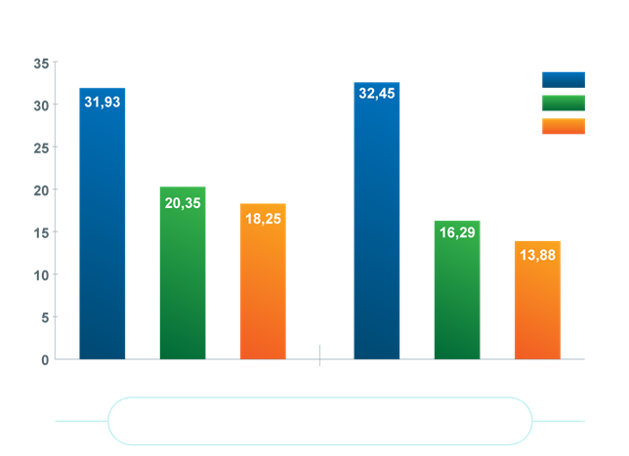
Management of Procedural Sedation Risks
While being beneficial for patients and helpful for clinicians in performing procedures effectively, procedural sedation carries significant risks.
Patients are at risk of respiratory depression, which may lead to serious injury or even death. Depending on the depth of sedation, patients may experience apneas or airway obstructions.
Excessive sedation may cause a slower recovery and a longer hospital stay.
Mouth Breathing et CO₂ Measurement
Oridion
Salter
GE
mm Mercury
Room Air
O₂ 2 I/m
Procedural Sedation is used in most “minimal invasive” procedures not requiring general anesthesia.
Source: *Derived from Schacter et al, Crit Care Med 1980 – as used in Egan, Fundamentals of Respiratory Care 6th Ed.

Slide 34
Sacral Nerve Stimulation (SNS) for Incontinence
The use of SNS in the treatment of incontinence have been found to be cost-effective compared to alternative treatments. For this reason, the NICE recommends the treatment of incontinence with SNS. However, in certain countries, this treatment is not funded. Consequently, several projects have been developed for the use of treatment in these countries.
 | HEALTHCARE OUTCOME MEASURE | SUCCESS INDICATOR AT THE END OF 12 MONTHS
1 | Number of weekly incontinence episodes | 50% decrement in the frequency of weekly incontinence episodes
2 | International Consultation on Incontinence Questionnaire Bowel Consultation (ICIQ-B) | Average ≥ 2.0 decrement in three domain scores
3 | Rockwood fecal incontinence quality of life (FIQL) questionnaire. | ≥ 0.4 improvement in overall score
4 | Treatment satisfaction questions: 1. Would you get this treatment again? 2. Would you recommend this treatment to others? | The answer to both questions is “Yes”
Source: *Derived from Schacter et al, Crit Care Med 1980 – as used in Egan, Fundamentals of Respiratory Care 6th Ed.

Slide 35
Training Technical Teams and Healthcare Professionals as an Added Value
According to a study carried out by the World Health Organization, the maintenance of medical devices and the support for healthcare professionals can only be properly materialized with trained technical personnel. The training provided by competent technical personnel for healthcare professionals contributes greatly to the correct and effective use of medical devices, patient safety, and sustainability.
Purpose | Explaining the need to train technical personnel in order to increase medical device usage in technologically developing countries
Participants | Students: 80% engineers, maintenance & calibration staff, technicians, 10% nurses, 10% others
Outputs | After the completion of courses, Doing the job better - 100% Being able to improve/develop the support and management of medical devices and systems - 100% High level of service improvement Other outputs - Safety, Application and Management
WHO: Improving Medical Device Availability,
Cost-Effectiveness and Safety: Online Courses on Principles, Application, Support and Management

Slide 36
Annexes

Slide 37
Complements to Value-Based Healthcare:
Outcome and Experience Measures
Patient-related outcome measures (PROM) are surveys that assess the opinions of patients regarding their health status. Patient-related experience measures (PREM) are surveys that assess the perceptions of patients regarding their experiences while receiving healthcare¹.
PROMs have been used in many studies that aim to strengthen treatment models with information about patient experience related to design, survival, and risk factors, thereby supporting the decisions of surgeons and clinicians. Since Value-Based Procurement is defined as “significant outcomes for people at the lowest cost possible,” the contribution of patient experience is a fundamental step in the improvement of healthcare delivery and sustainability².
PROM also complements traditional data sources, such as information obtained from clinical administrative data, to support policies, programs and value-based healthcare delivery. It is crucial in terms of understanding whether healthcare services and procedures make a difference to patient health status and quality of life³.
Source: 1. Patient-reported outcome measures and patient-reported experience measures: Charlotte Kingsley, MBBS BSc FRCA, Sanjiv Patel, MBBS BMedSci FRCA 2. Pay less and spend more—the real value in healthcare procurement: Federico Pennestrì1, Giuseppe Lippi2, Giuseppe Banfi1,3 3. https://www.cihi.ca/en/patient-reported-outcome-measures-proms
For more information: https://link.springer.com/article/10.1007/s10198-019-01070-1
https://www.fda.gov/files/about%20fda/published/Value-and-Use-of-Patient-Reported-Outcomes-%28PROs%29-in-Assessing-Effects-of-Medical-Devices.pdf

Slide 38
Turkish Legislation and Practices
Law No: 4734 on Public Procurement
Applicable procurement procedures (Articles 18, 19, 20, 21 and 22)
Evaluation of tenders (Articles 37, 38 and 39)
The economically most advantageous tender and non-price factors (Article 40)
“The economically most advantageous tender is determined solely based on price or together with the price by taking into account the non-price factors such as operation and maintenance costs, cost-effectiveness, productivity, quality and technical merit. In tender proceedings where the economically most advantageous tender shall be determined by considering the non-price factors in addition to the price, these factors must be expressed in monetary values or relative weights in tender documents.”

Slide 39
For More Information About Value-Based Procurement:
1. How Procurement Unlocks Value-Based Healthcare
2020_MTE_How-Procurement-Unlocks-Value-Based-Health-Care-Jan-2020.pdf (medtecheurope.org)
2. Event report – 1st European Value-Based Procurement Conference: a new paradigm in healthcare Why Value-Based Procurement now?
2019_VBPC-Event-Report.pdf (medtecheurope.org)
3. How to successfully implement (MEAT) Value-Based Procurement - what we have learned from learning projects & pilots so far
4_How_to_implement_a_VBP_project_v16.pdf (tmabevents.be)
4. Overview and access to the MEAT VBP guidelines & Excel tool
Define concept and educate on MEAT VBP (tmabevents.be)
5. Procurement: the unexpected driver of value-based healthcare
Public Procurement Health Care.indd (tmabevents.be)

Slide 40
Thanks

